Slide 1
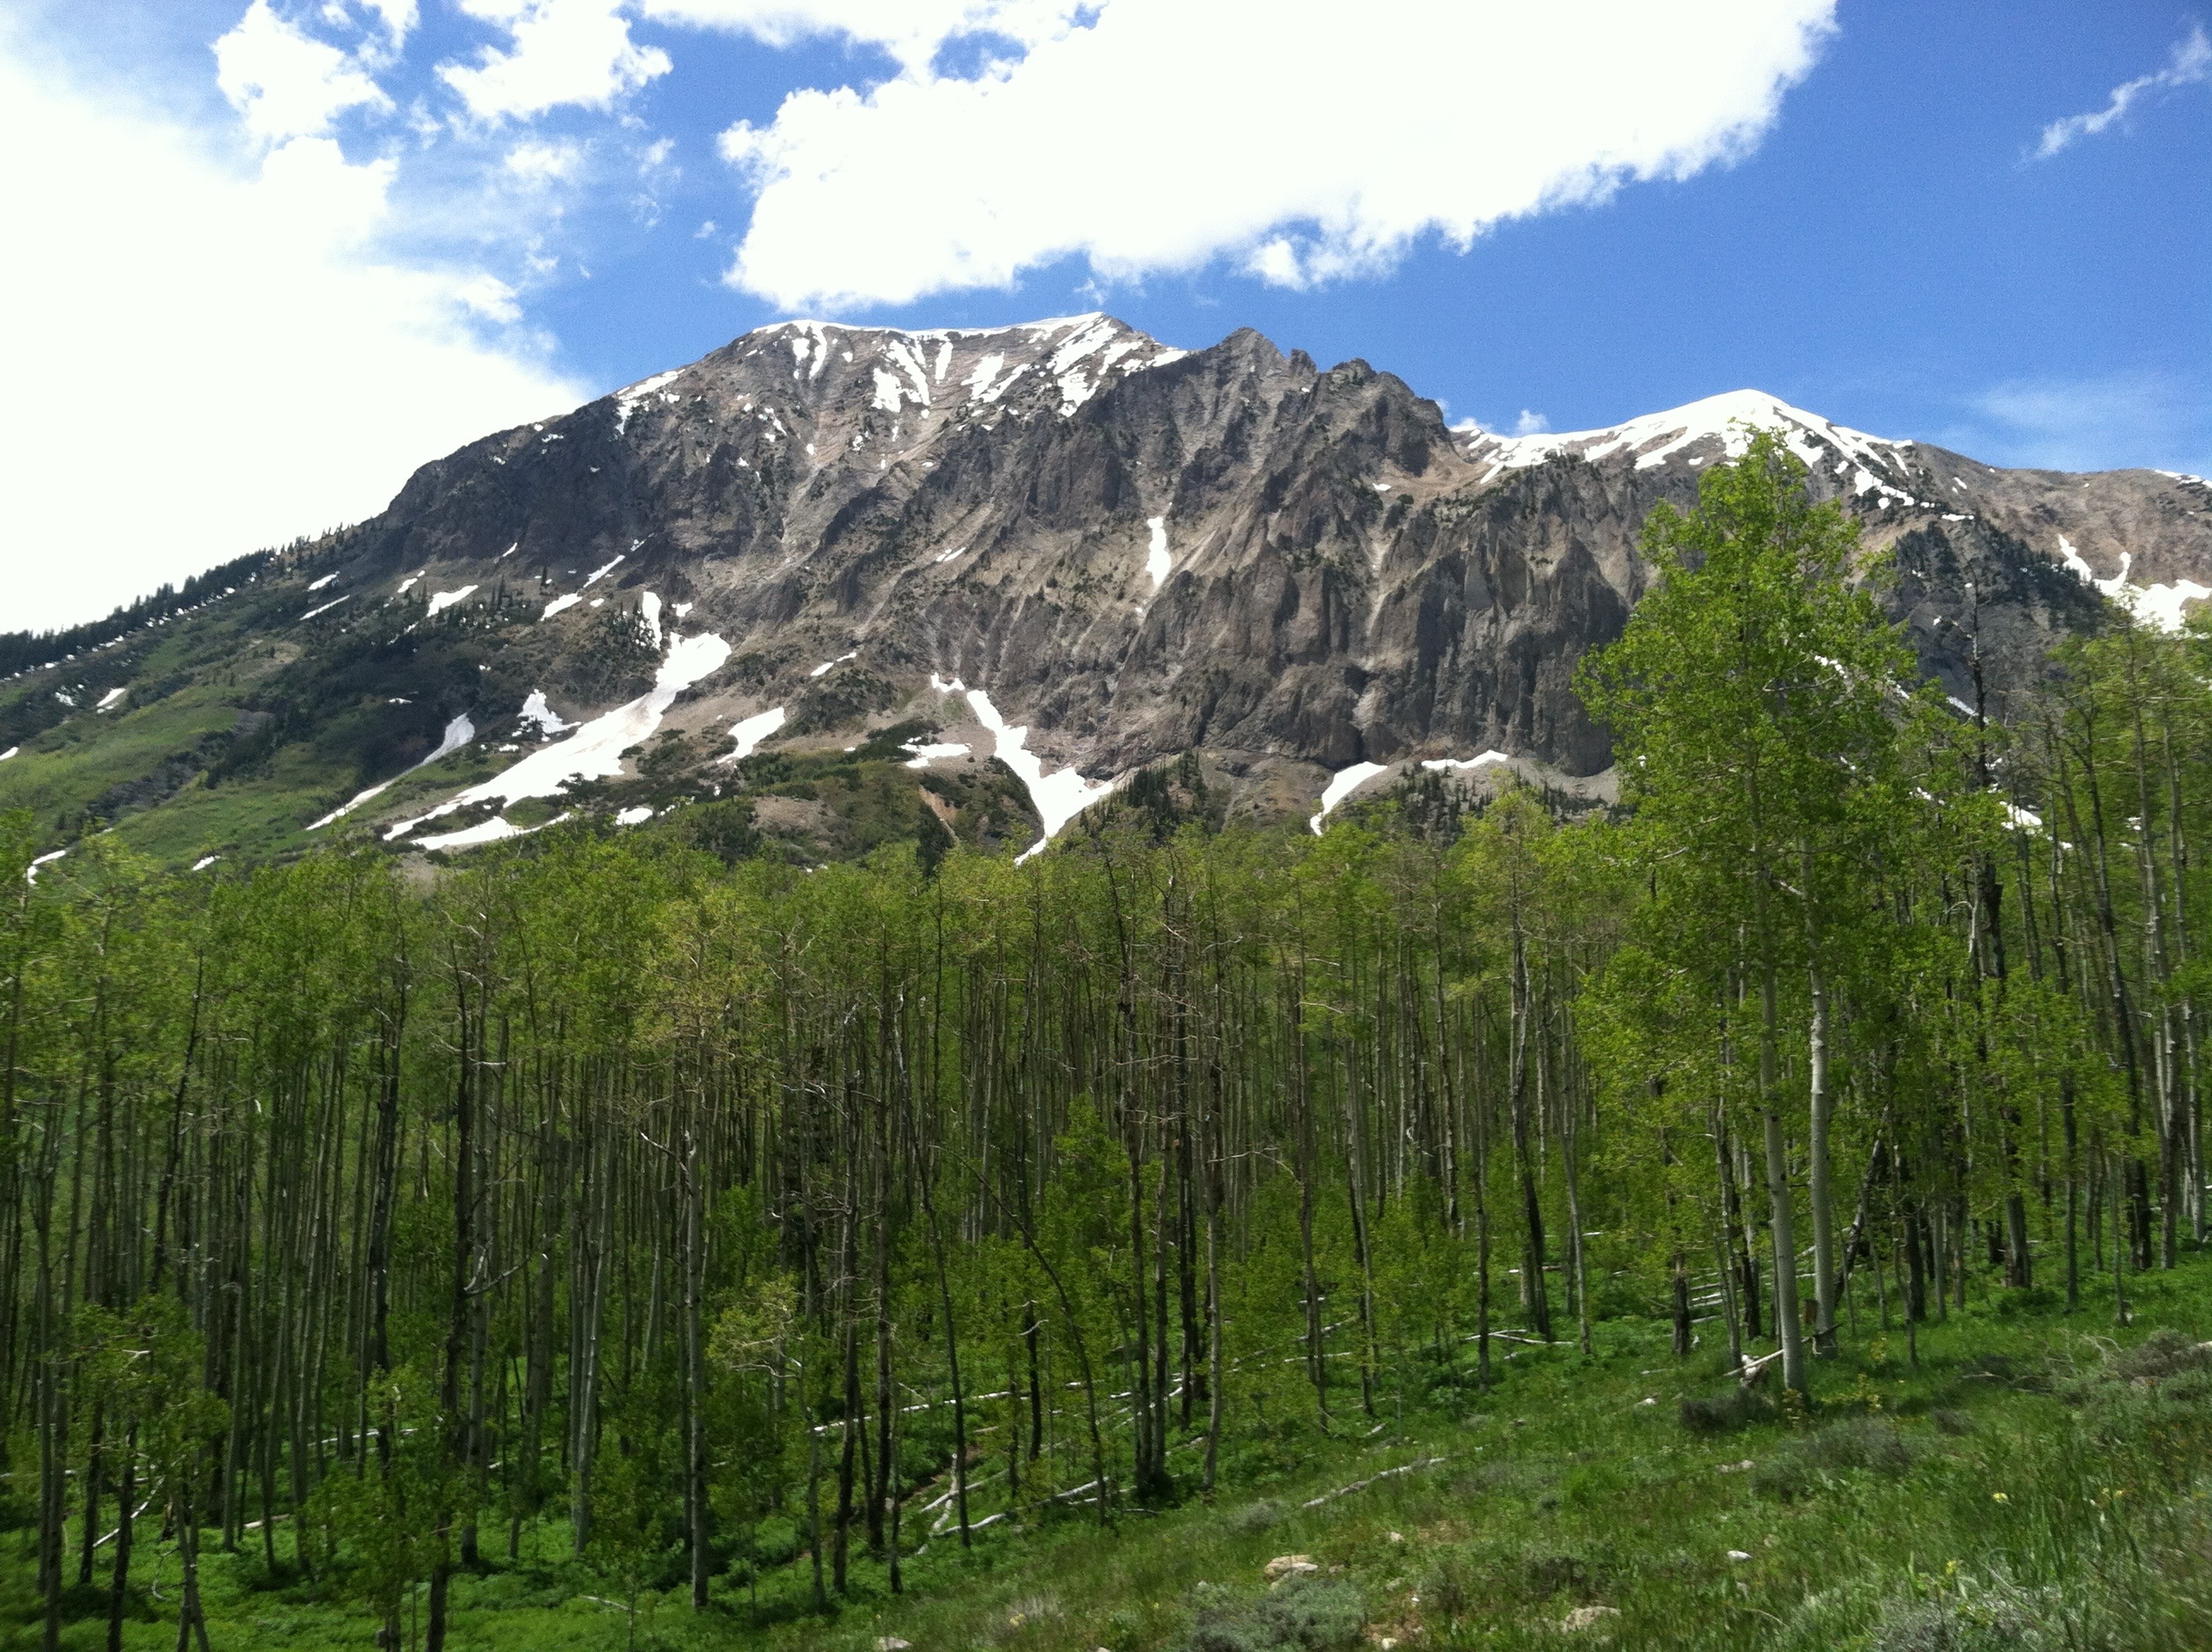
Potential for climate-induced disruption of plant-fungal symbioses in the Rocky Mountains
Melanie Kazenel
7 April 2016

Slide 2
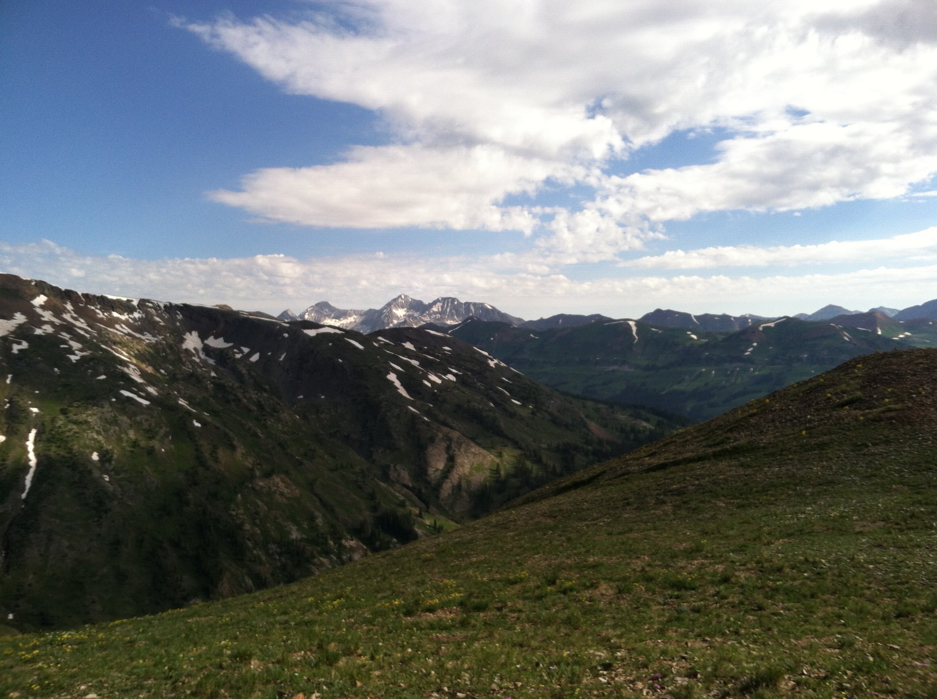
How will climate change alter plant-symbiont interactions?
Notes:
Start on this slide
I work in the Rocky Mountains of Colorado, where we study grasses in mountain systems like this one
Specifically, we study the ecology of interactions between grasses and the fungal symbionts that they associate with
My work is part of a multi-part project where we’re examining how climate change might alter plant-symbiont interactions.
I’m going to talk today about two components of that project.
Examining grasses and their fungal symbionts in the Rocky Mountains of Colorado, seeking to characterize how climate change may alter these relationships.
(I study native grasses in the Rocky Mountains of Colorado and the fungi that they associate with, looking at how climate change might alter these interactions)

Slide 3
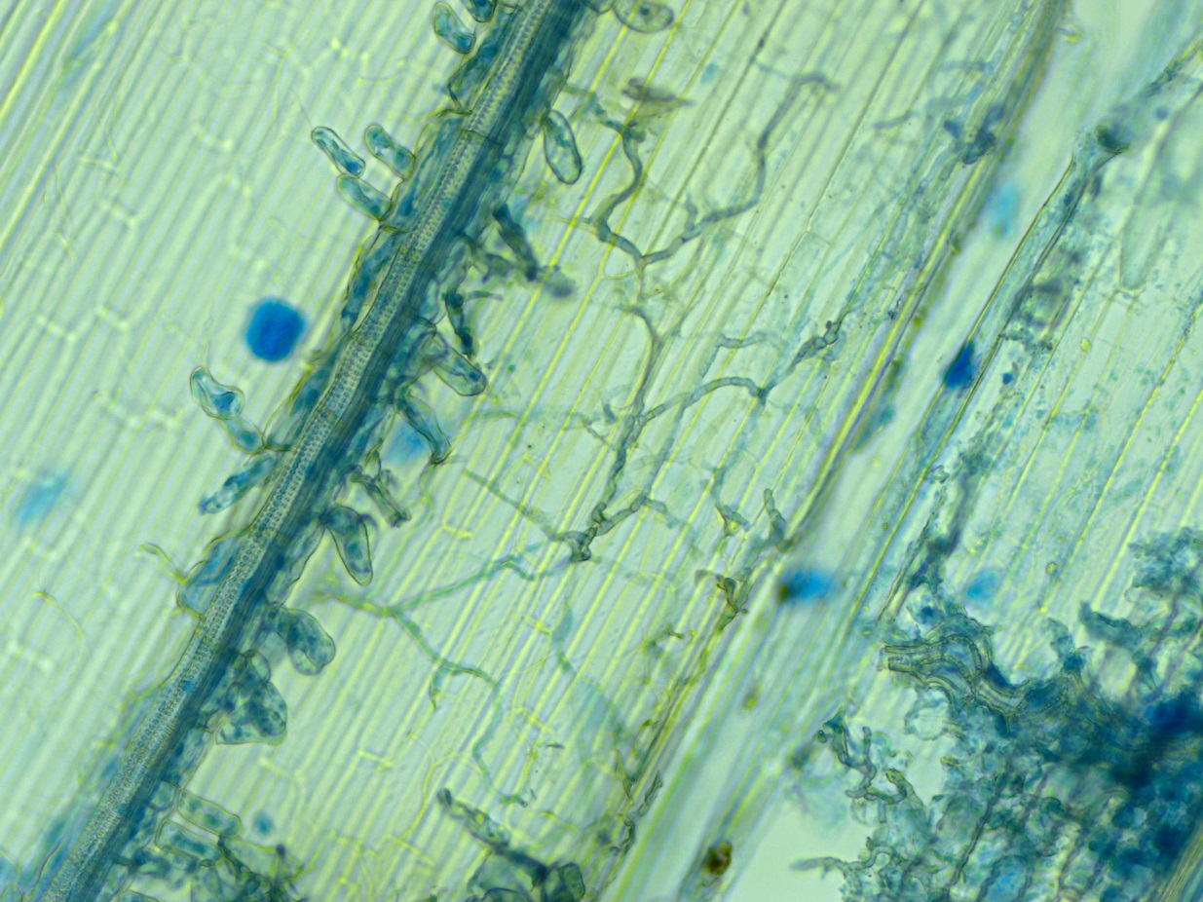
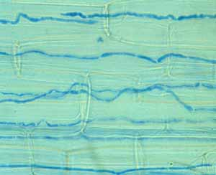
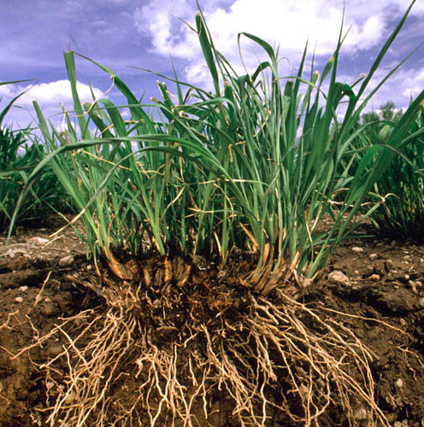
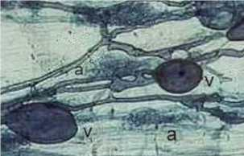
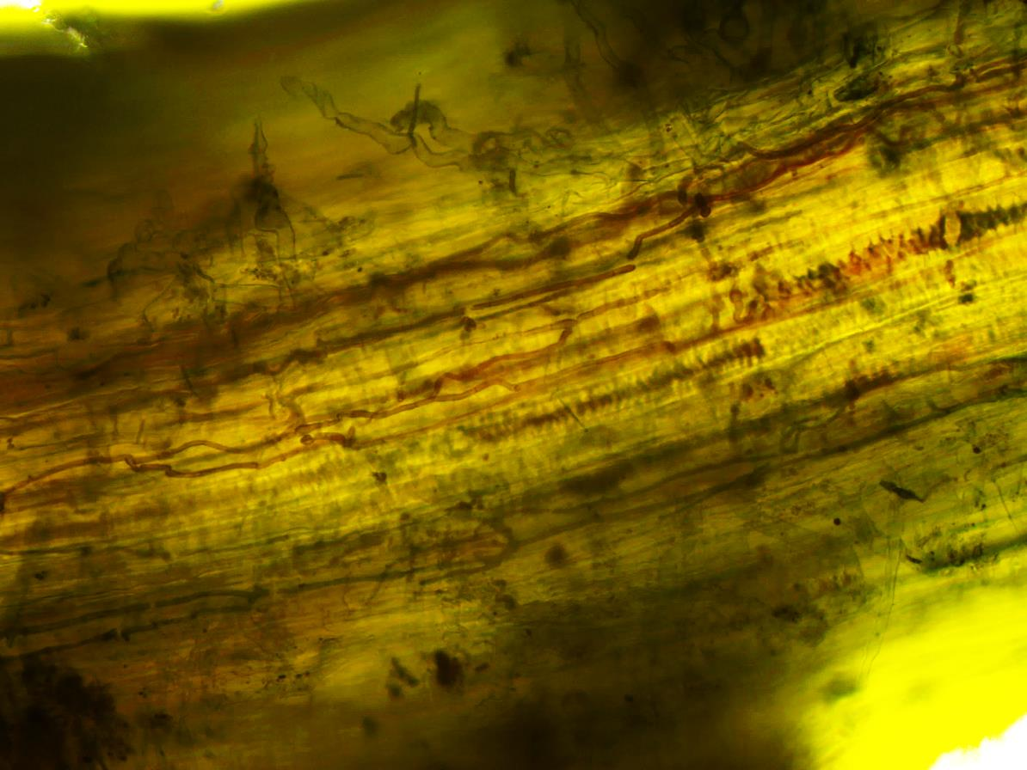
Plants and Fungal Symbionts
Systemic endophytes (Epichloë sp.)
Localized foliar
endophytes (LFE)
Arbuscular mycorrhizal
fungi (AMF)
Dark septate
endophytes (DSE)
Notes:
Say synergisms or antagonisms; specify that the Epichloe that we study are vertically transmitted, but not all are. Systemic: single individual fungus that in aboveground portion of plant.
Say
First, I wanted to give you a bit of background.
Plants commonly host a consortium of microbial symbionts that associate with both leaves and roots
These microbes include fungal pathogens that can inhabit both roots and leaves of plants
However, a number of these microbes are mutualistic, providing with both plant and microbe acquiring a benefit from the relationship
Belowground, plants associate with a number of different types of mutualistic microbes, including
Mycorrhizal fungi, which can provide plants with nutrients and water in exchange for carbohydrates
Plants also associate with other fungi such as dark septate endophytes
As well as rhizosphere bacteria
Aboveground, plants can harbor systemic fungal endophytes that exist throughout the aboveground tissue, as well as localized foliar endophytes
Systemic endophytes can provide plants with protection against herbivores, pathogens, and drought, in exchange for nutrition and protection
http://gaudin.ucdavis.edu/?page_id=159

Slide 4
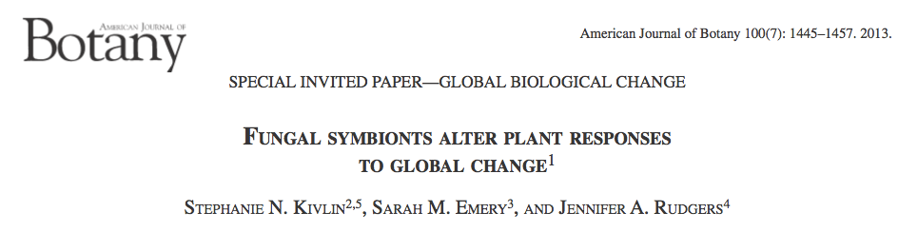
Symbionts can mediate plant responses to climate change
Symbionts altered plant responses to drought, N deposition, and warming
Notes:
Among their ability to provide benefits to plants, it has been shown that symbionts can mediate plant responses to climate change
A meta-analyses published by members of our lab
Examined how plants associated with four classes of fungal symbionts (class I leaf endophytes [EF], arbuscular mycorrhizal fungi [AMF], ectomycorrhizal fungi [ECM], and dark septate endophytes [DSE]) responded to four global change factors (enriched CO2, drought, N deposition, and warming).
meta-analysis of 434 studies spanning 174 publications
Examined 4 classes of fungi and 4 global change factors: CO₂ enrichment, drought, N deposition, and warming
Symbionts altered plant responses to all except CO₂
Strongest fungal mediation of plant responses for drought and N deposition

Slide 5
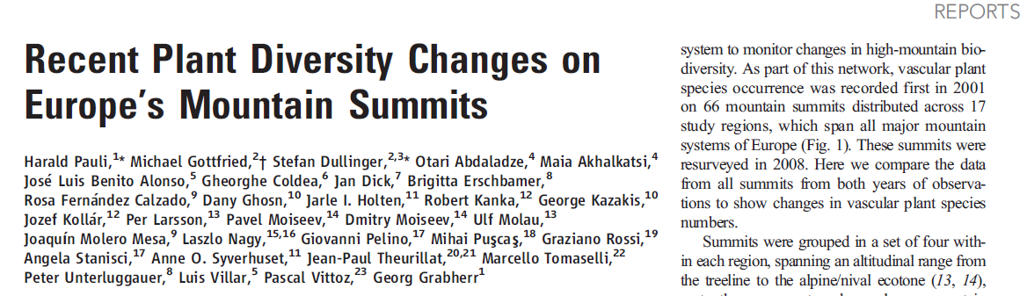
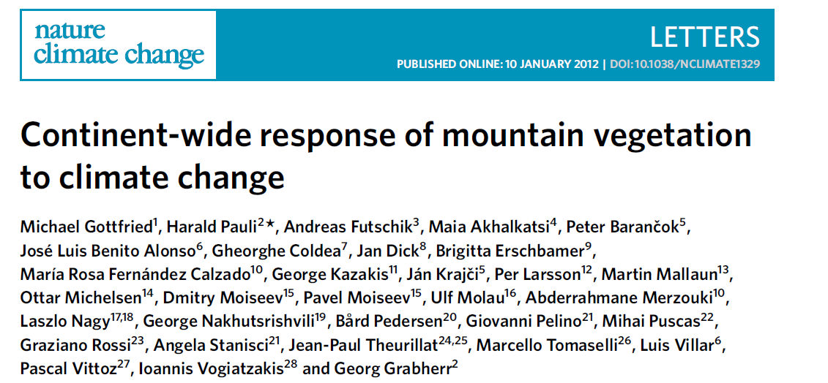
Climate change may disrupt symbioses as organisms experience range shifts
Notes:
In addition, studies have documented movement of plants up mountains in response to both current and historic climate change, and these range shifts have the potential to disrupt plant-fungal symbioses.
Recent surveys show upward movement of plants on mountains worldwide, with ranges of cold-adapted species shrinking and warm-adapted species expanding (Walther et al. 2005, Lenoir et al. 2008, Gottfried et al. 2012, Pauli et al. 2012). For example, in Europe, climate forecasts for 2070–2100 projected the loss of 80% of suitable habitat for up to 50% of alpine and montane species, with greater losses for species restricted to the highest elevations (Engler et al. 2011).
Pauli:
- Species have moved upslope on average.
- Shifts increased species richness is boreal-temperate mountain regions, but decreased species richness in Mediterranean mountain regions, probably because of decreased water availability with climate shifts in Med. regions

Slide 6

Mechanisms for disruption of plant-symbiont interactions
Plants and symbionts may have different:
Physiological tolerances
Dispersal rates
Phenological responses
Notes:
Dispersal pictures for fungi and grasses. Explain phenological.
Phenology: life cycle events and how they are influenced by climate.
As altitudinal range shifts occur with climate change, they may alter plant’ interactions with both leaf- and root-associated fungal symbionts through several possible mechanisms/pathways.
Fungi and plants may have independent physiological responses to climate change → distributions may become decoupled
Both plants and their symbionts could have similar physiological tolerances to climate, but realize different distributions due to disparities in their dispersal abilities
Climate change could alter the context-dependent outcomes of symbioses → prevalence of symbiosis could increase or decrease

Slide 7
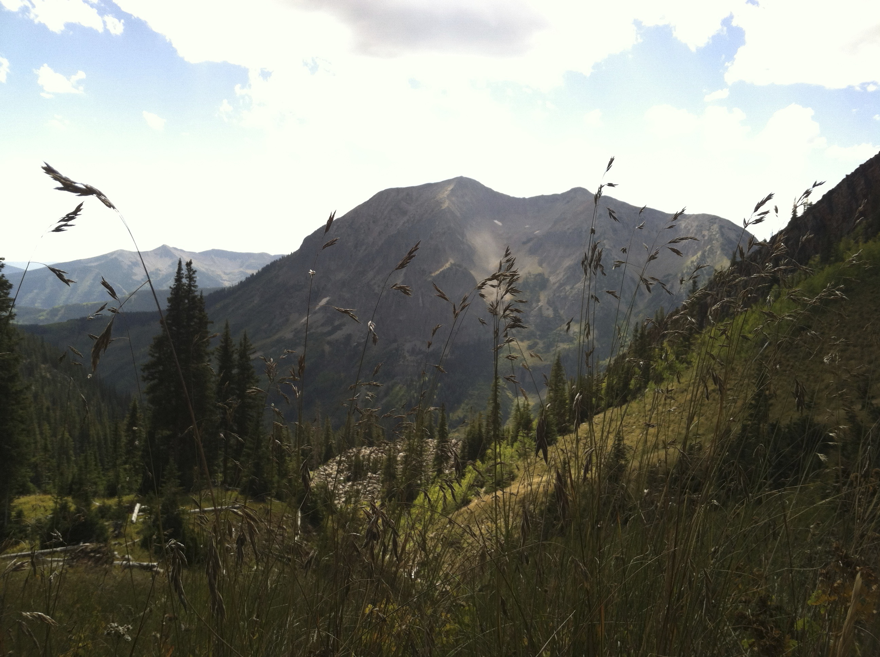
Study System
Mountains
~25% of land area on Earth
50% of the human water supply
1/3 of terrestrial plant diversity
Grasses
Cover 1/3 of land area (>10,000 species)
Provide the majority of food for humans and domesticated animals
All have mycorrhizal fungi in roots and fungi in leaves
Notes:
For this work, as I mentioned, we’re studying grasses and their fungal symbionts in the Rocky Mountains of Colorado, based at RMBL
Mountains are globally important systems; grasses are widespread

Slide 8
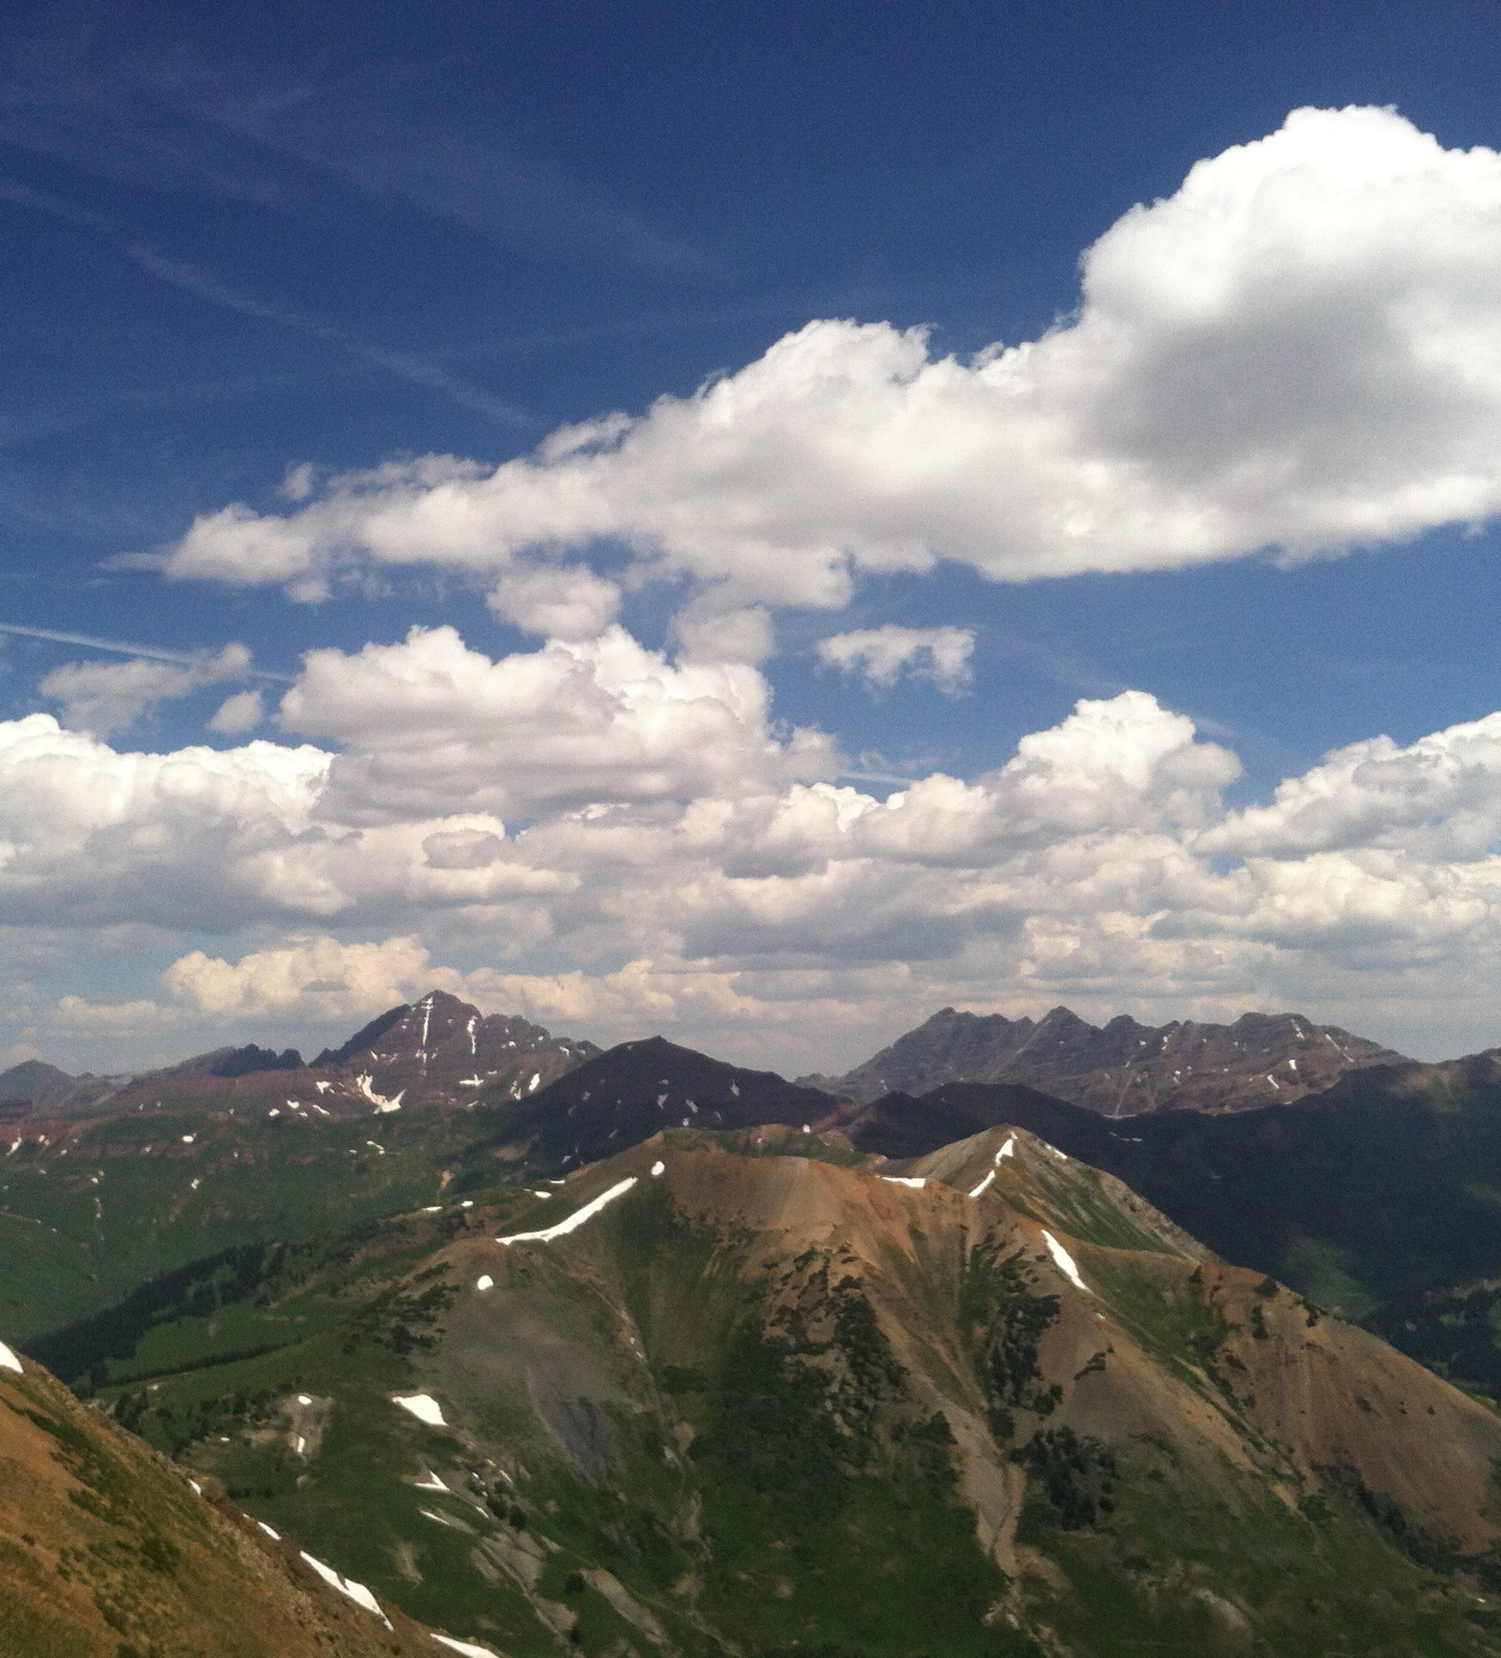
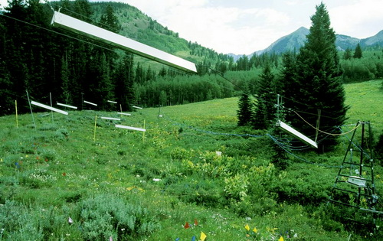
Altitudinal Gradients
Experimental Warming
Photo: Mary Ellen Harte
Notes:
Our study location allows us to make use of two valuable tools for documenting how climate shifts affect symbioses.
Being in the mountains gives us access to natural altitudinal gradients, where temperature and precipitation change with elevation → “space for time” substitution
We’re also able to make use of a long-term warming experiment where half of the plots are heated to 2 degrees above ambient temperature
This gives us two different means of examining how symbioses respond to temperature change
In addition, most studies along altitudinal gradients have been conducted for a single fungal group; no study has looked at all four groups.
Very few studies have looked at experimental warming effects on fungal symbionts.
The degree to which altitudinal patterns will predict species responses to warming (space for time substitution) has received little attention for fungi
Highlight what we don’t know. Lots of examples for single fungal group; no study has looked at all four groups in a single systems for alt gradients. Only X studies worldwide has looked at warming effects of fungal symbionts.

Slide 9
Focal questions
How do symbionts change with altitude and warming?
Altitude response?
Warming response?
Are they the same?
Notes:
Altitudinal response, warming response, are they the same?
So with that, to address our overarching question of…
We’re asking (a) and (b)
I’m going to focus first on the altitudinal gradient portion of our work

Slide 10
Warming Experiment Rocky Mountain Biological Laboratory
Photo: Mary Ellen Harte
Established in 1991
Warms top 15 cm of soil by ~2°C
Dries soil by 10-20%
Extends growing season by ~12 days on each end
Notes:
Oldest warming experiment
Established in 1991, consists of 10 plots, half heated by infrared lamps

Slide 11
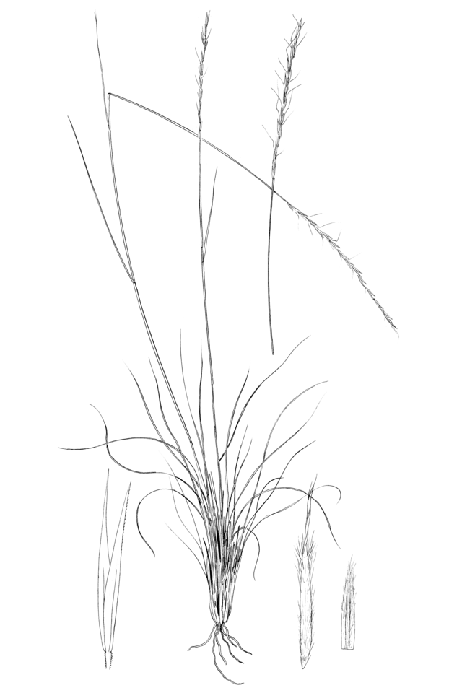
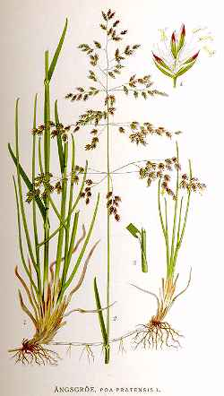
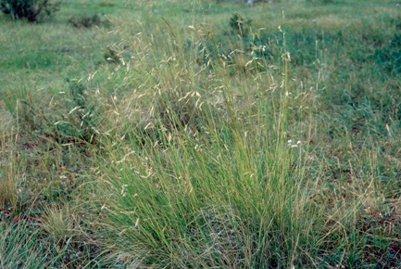
Study Species
Achnatherum lettermanii
(ACLE)
Poa pratensis
(POPR)
Festuca thurberi
(FETH)
Notes:
We’re studying 3 grass species

Slide 12
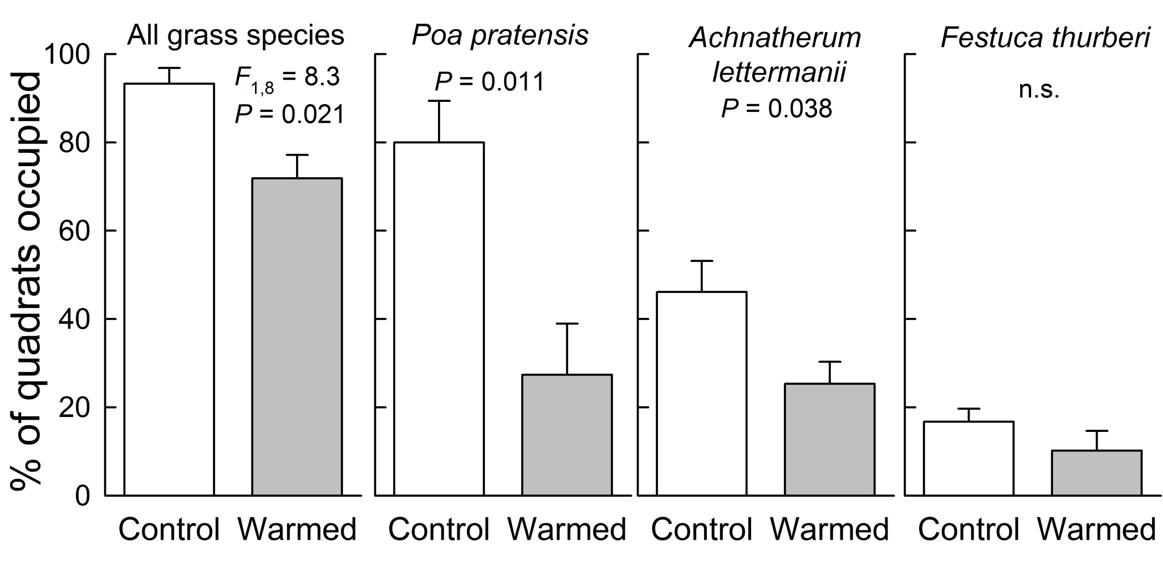
Experimental warming reduced grasses
(1991 – 2011)
25%
66%
45%
Mean % ± s.e. of 49 (0.2m×0.2m) quadrats surveyed per plot
n = 5 plots per warming treatment
Rudgers et al. Ecology (2014)

Slide 13
Experimental warming increased mycorrhizal colonization of roots
P = 0.025
A. lettermanii
Arbuscular mycorrhizal fungi
Rudgers et al. Ecology (2014)

Slide 14
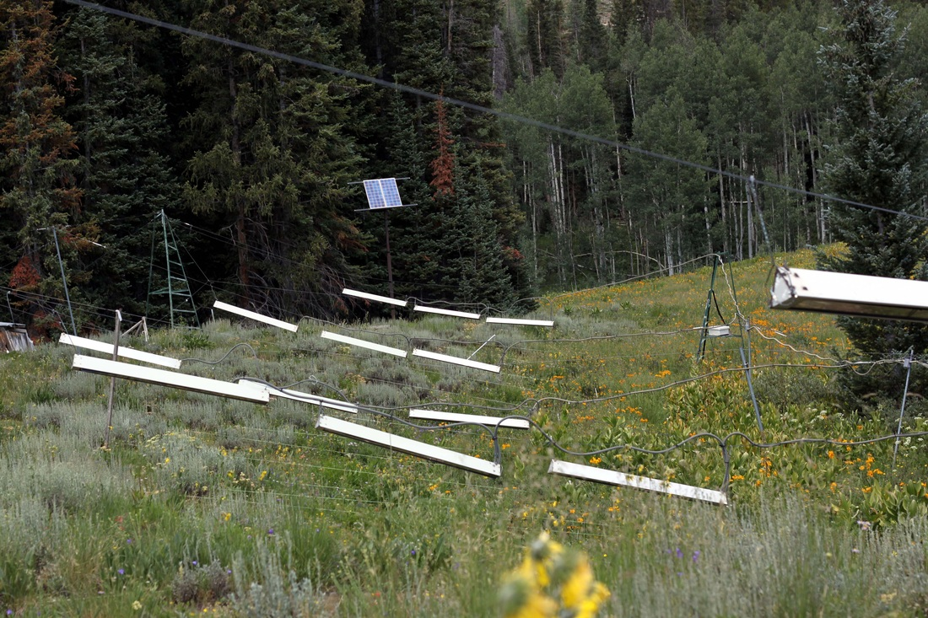
Field collection methods
3 focal grass species:
Achnatherum lettermanii
Poa pratensis
Festuca thurberi
6 individual plants collected per species per plot
Roots and leaves (2014)
Phenology: June and September
Photo: Noah Whiteman
Notes:
Highlight phenology

Slide 15
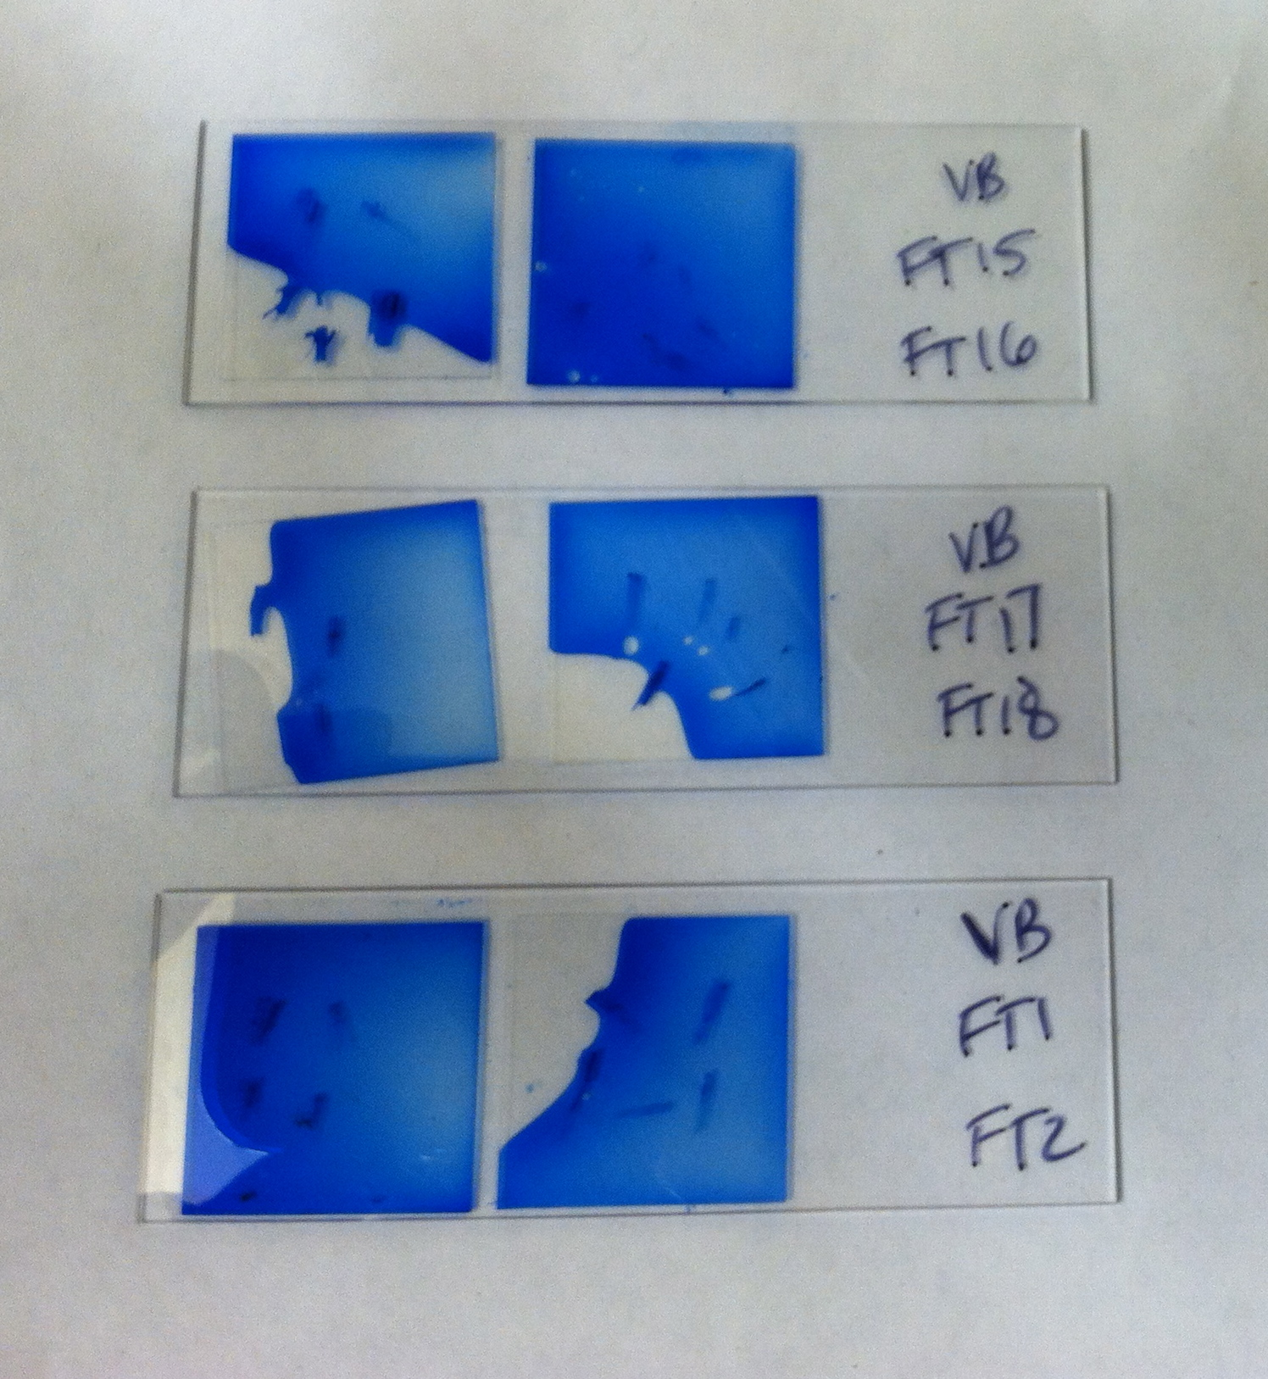
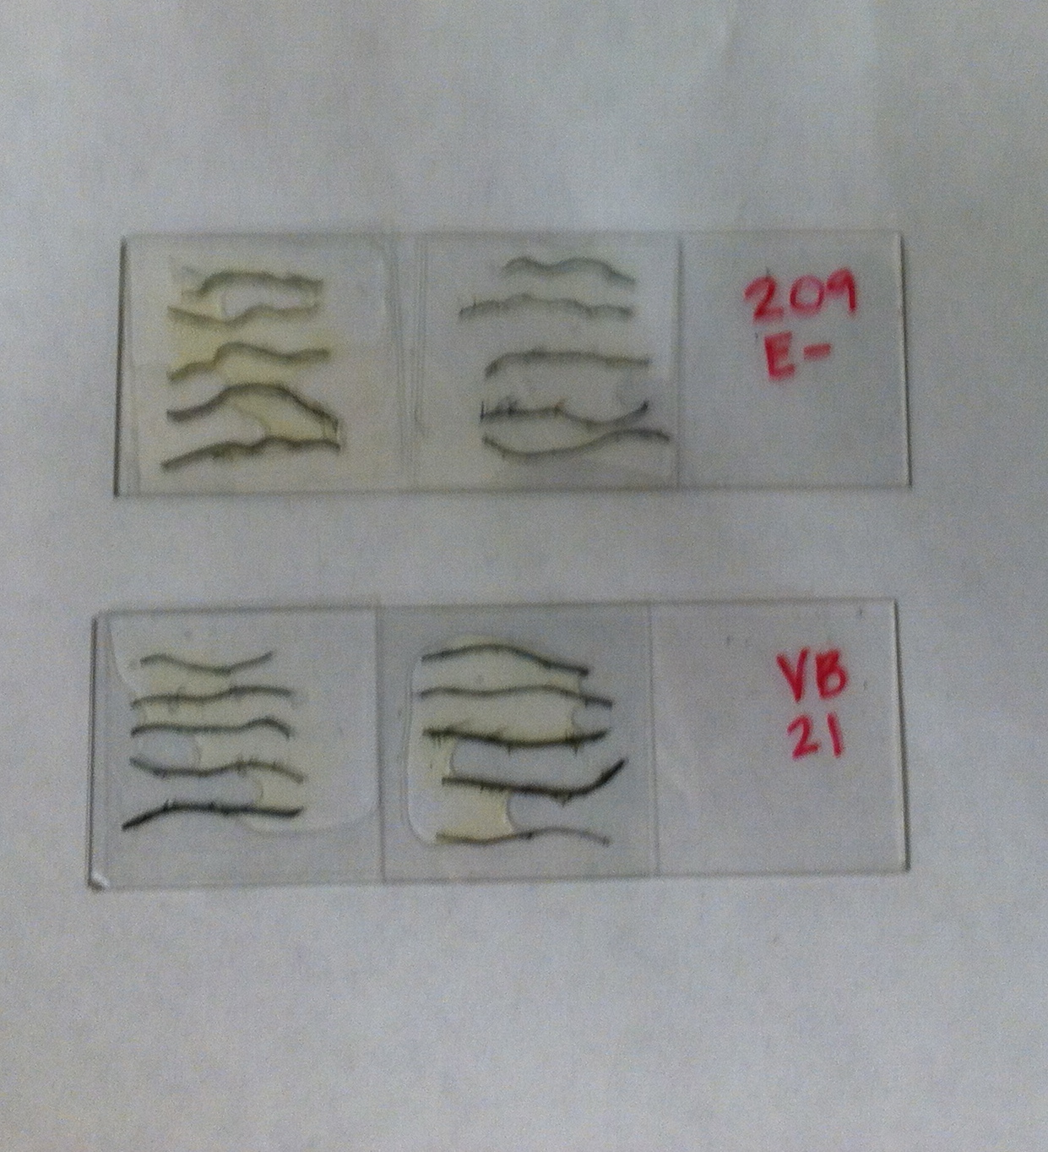


Laboratory methods
Staining and microscopy → colonization
Illumina MiSeq DNA sequencing → composition
Notes:
Microscopy allows examining of percent colonization of host tissue by fungal symbionts, which can give information about extent of the symbiosis within a host plant
However, microscopy just allows identification of symbionts into more coarsely defined functional groups
Sequencing can allow more fine scale identification of specific fungal taxa associated with plants, and can give information about how composition of the fungal community changes with temperature/elevation
Why do both things. Could also show culturing pictures.

Slide 16
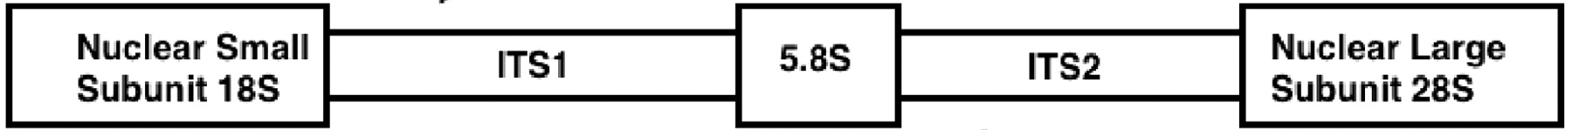
Illumina Sequencing
Paired-end sequencing of fungal nuclear ribosomal DNA using primers targeting:
ITS2 region (for VTE, LFE, and DSE)
~300bp in the 28S region (for AMF) (FLR3-FLR4 primers)

Slide 17
Bioinformatics
Quality filtering in QIIME
Sumaclust to place similar sequences into operational taxonomic units (OTUs) at ~97% identity
NCBI BLAST to assign taxonomy
Discarded all OTUs with <97% identity to entry in database
Normalized data using DESeq2
Discarded singletons
→ Conducted analyses on 802 OTUs

Slide 18
Analyses
NMDS: to visualize OTU composition
perMANOVA: to test how variables of interest affect OTU composition
Fixed effects: warming treatment, host species, sampling date
Random effect: block (pair of plots)
PERMDISP: to test for dispersion within groups
Indicator species analysis (SIMPER): to identify OTUs that contributed strongly to differences among groups

Slide 19
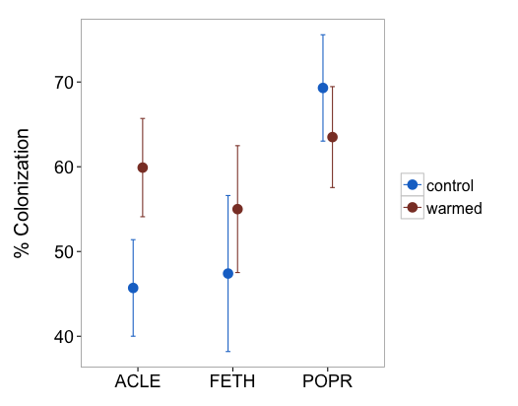
P = 0.0385
Arbuscular mycorrhizal fungi
Notes:
Make titles more descriptive
For synthesis slide: compare alt. vs. warming graphs. Could had slide for each species. Change colors for warmed vs. control.
For A. lettermanii: higher colonization by arbuscular mycorrhizal fungi under warming
No trends for F. thurberi and P. pratensis
We found trends in fungal colonization with temperature change that differed among host species and symbiont groups
In our full model, there was a marginally significant interaction between warming treatment and host species (df = 44, t = 2.6957, P = 0.0786). Decomposing this effect, for A. lettermanii, colonization by AMF hyphae was ~31% higher in warmed relative to control plots (df = 12, t = -2.324, P = 0.0385). AMF hyphal colonization did not differ between control and warmed plots for F. thurberi and P. pratensis.

Slide 20
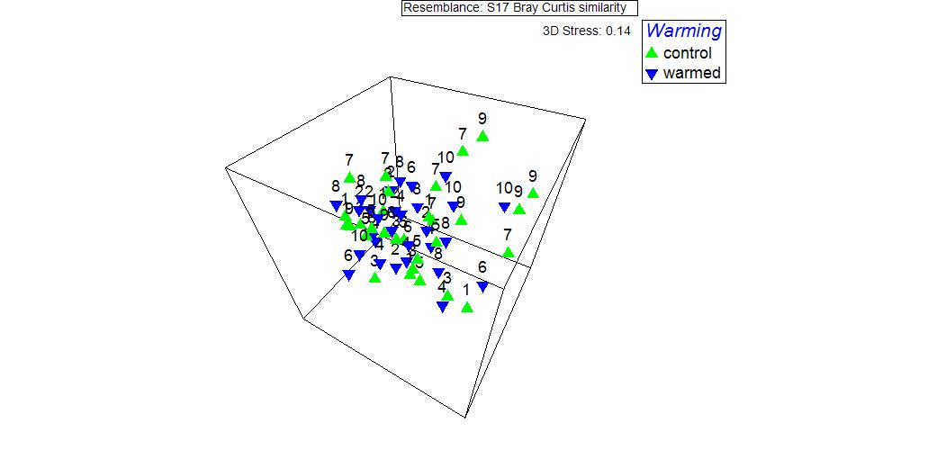
Results: All Species
OTU composition did not differ between warming treatments (df = 1, pseudo-F = 1.361, P = 0.1391)
High stress value
Spatial heterogeneity (significant effect of block)

Slide 21
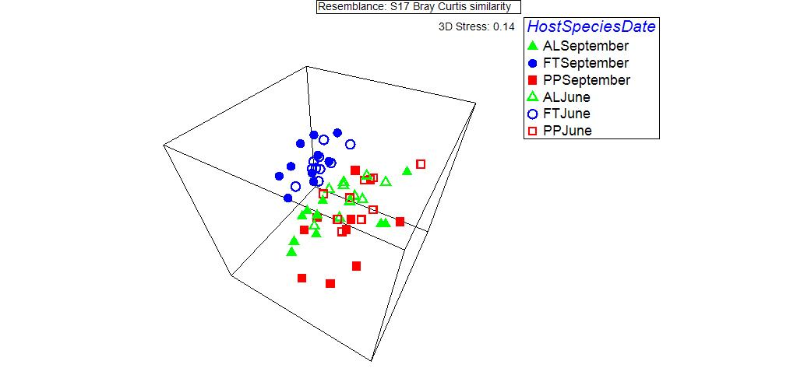
OTU composition differed between sampling dates (df = 1, pseudo-F = 2.9483, P = 0.0009) and among host species (df = 2, pseudo-F = 5.4469, P = 0.0001)
FT differed from AL and PP
Communities of AL and PP were significantly more dispersed relative to communities of FT (PERMDISP)

Slide 22
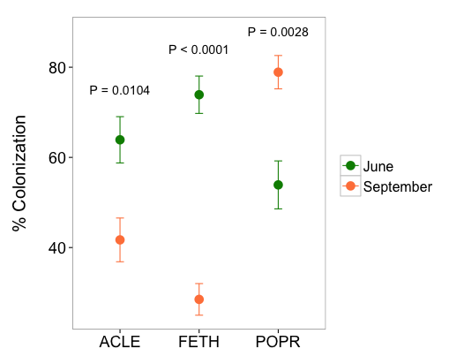
Changes in AMF colonization between June and September for all three grasses
Arbuscular mycorrhizal fungi
Notes:
We found trends in fungal colonization with temperature change that differed among host species and symbiont groups
Different trends for different species
Importance of sampling at different times of year
Climate change could have differential effects on the phenology of symbionts (considering the importance of phenology within different host clades)
Differences in colonization among species and sampling dates
Percent colonization by AMF hyphae varied among host species (df = 44, t = 7.2431, P = 0.0019) and by sampling date (df = 44, t = 15.702, P = 0.0003), with a significant host species x sampling date interaction (F_{2,44} = 33.4079, P < 0.0001). There were ~35% and ~61% decreases in colonization for A. lettermanii (df = 44, t = 3.577, P = 0.0104) and F. thurberi (df = 44, t = 7.314, P < 0.0001), respectively, and an ~46% increase in colonization for P. pratensis (df = 44, t = -4.028, P = 0.0028) between June and September
Similar trends for DSE: significant effects of host species and host species x date interaction

Slide 23
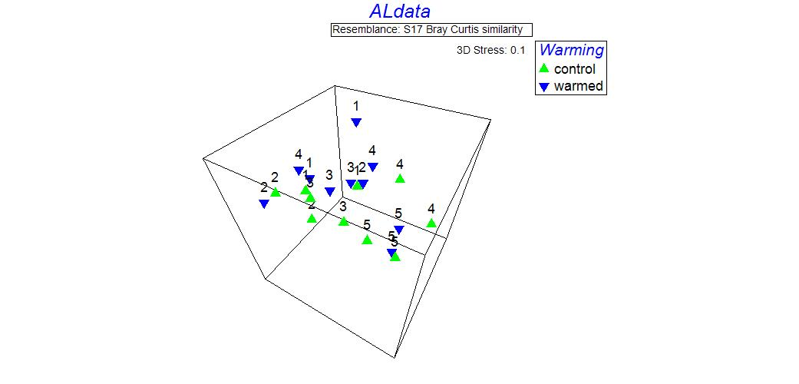
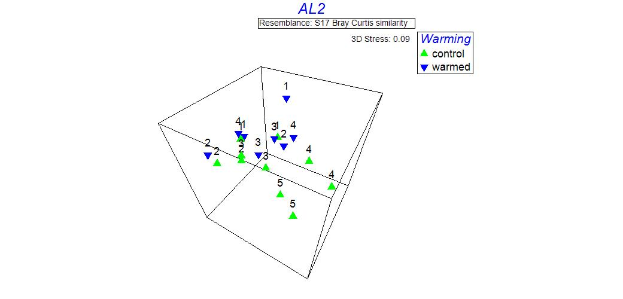
Results: A. lettermanii
All data
Plot 10 data removed

Slide 24
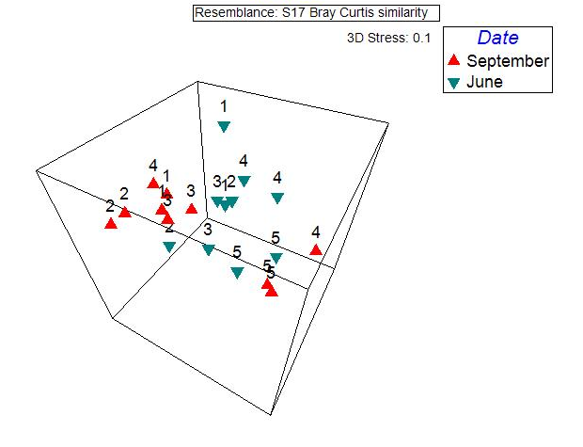
Sampling date affected OTU composition (df = 1, psuedo-F = 3.1274, P = 0.0024
No difference in dispersion between two dates
Grouping by plot

Slide 25
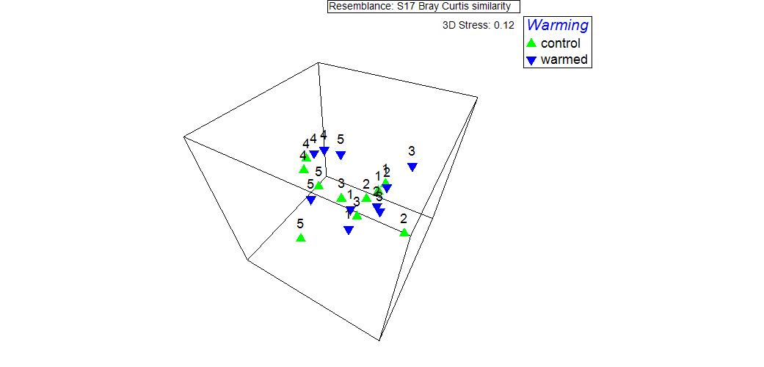
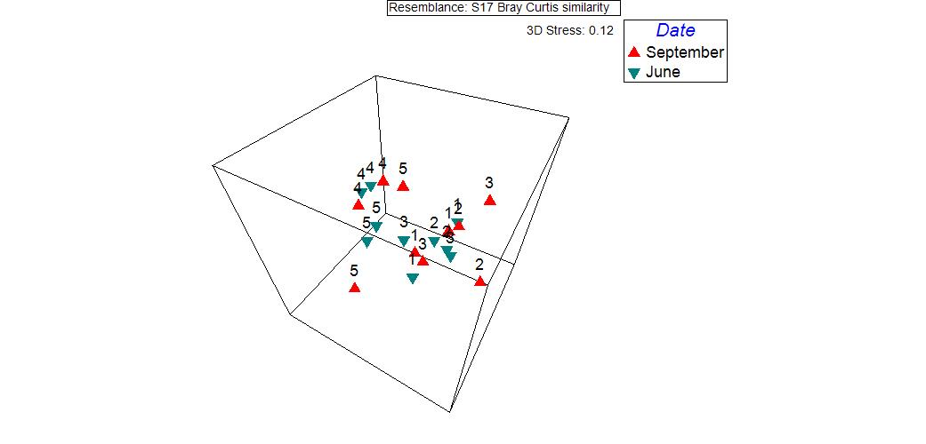
Results: F. thurberi
No effect of warming or sampling date

Slide 26
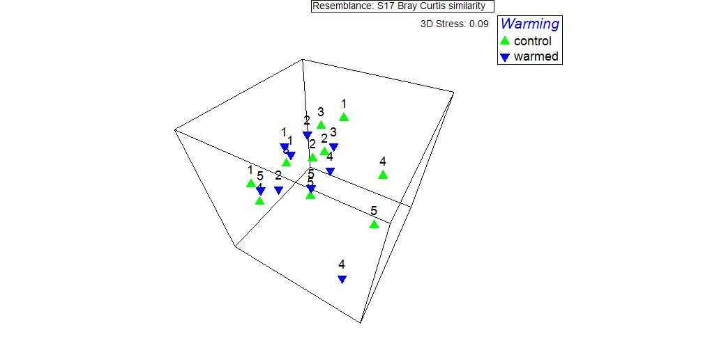
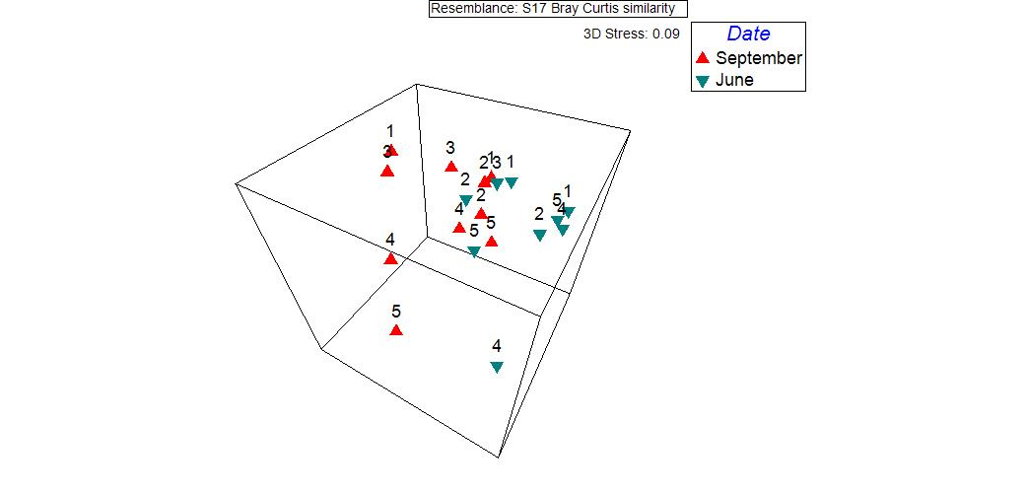
Results: P. pratensis
No effect of warming
Effect of sampling date (df = 1, pseudo-F = 2.6595, P = 0.0065

Slide 27
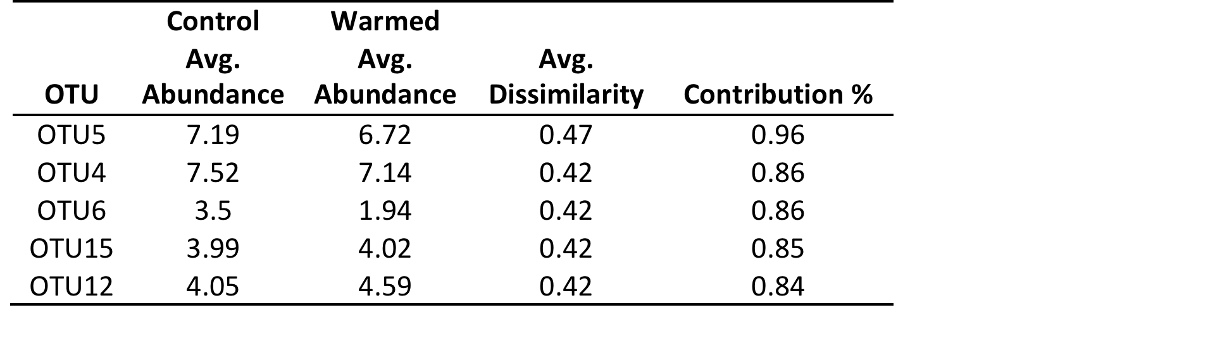
Indicator Species Analysis (SIMPER)
Control vs. warmed plots

Slide 28
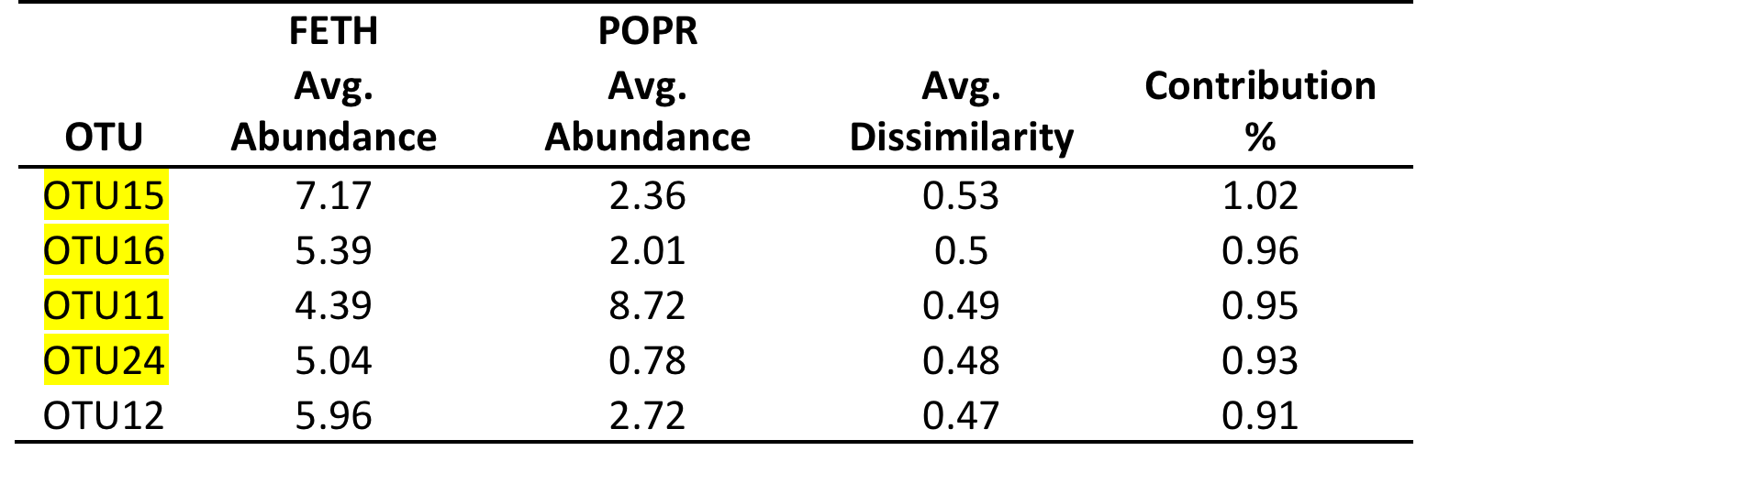
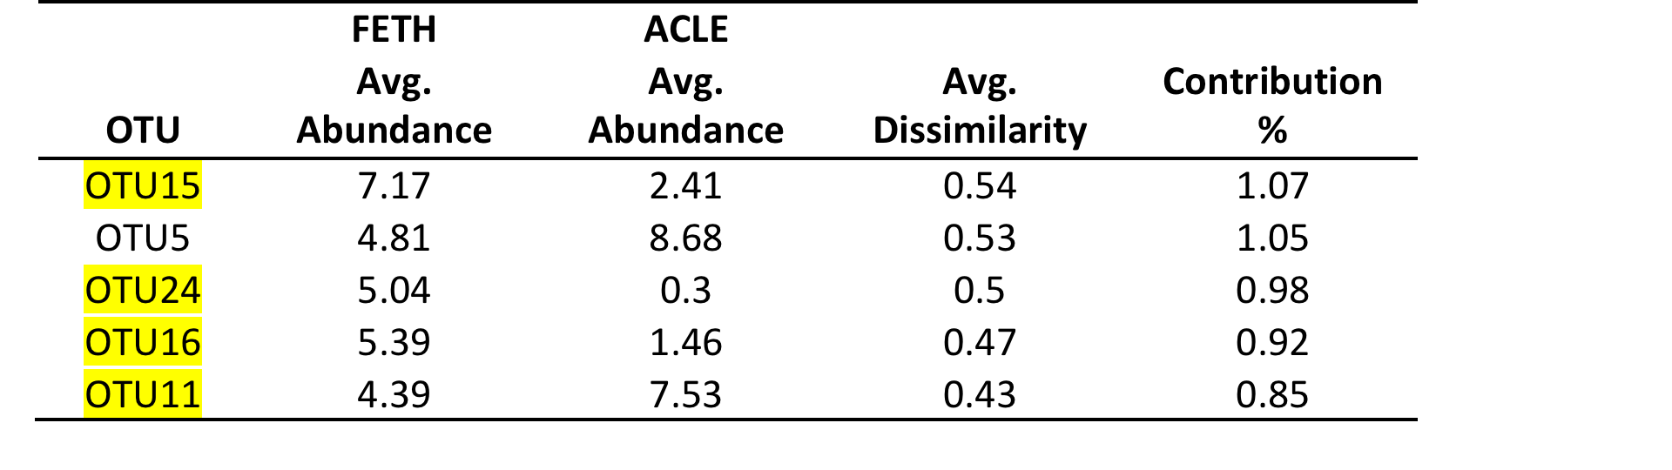
F. thurberi vs. P. pratensis
F. thurberi vs. A. lettermanii

Slide 29
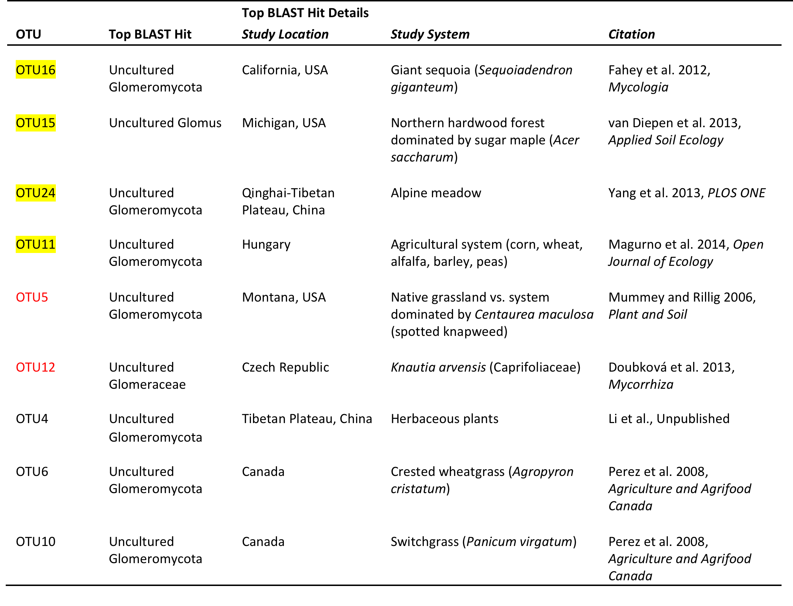
Taxonomy

Slide 30
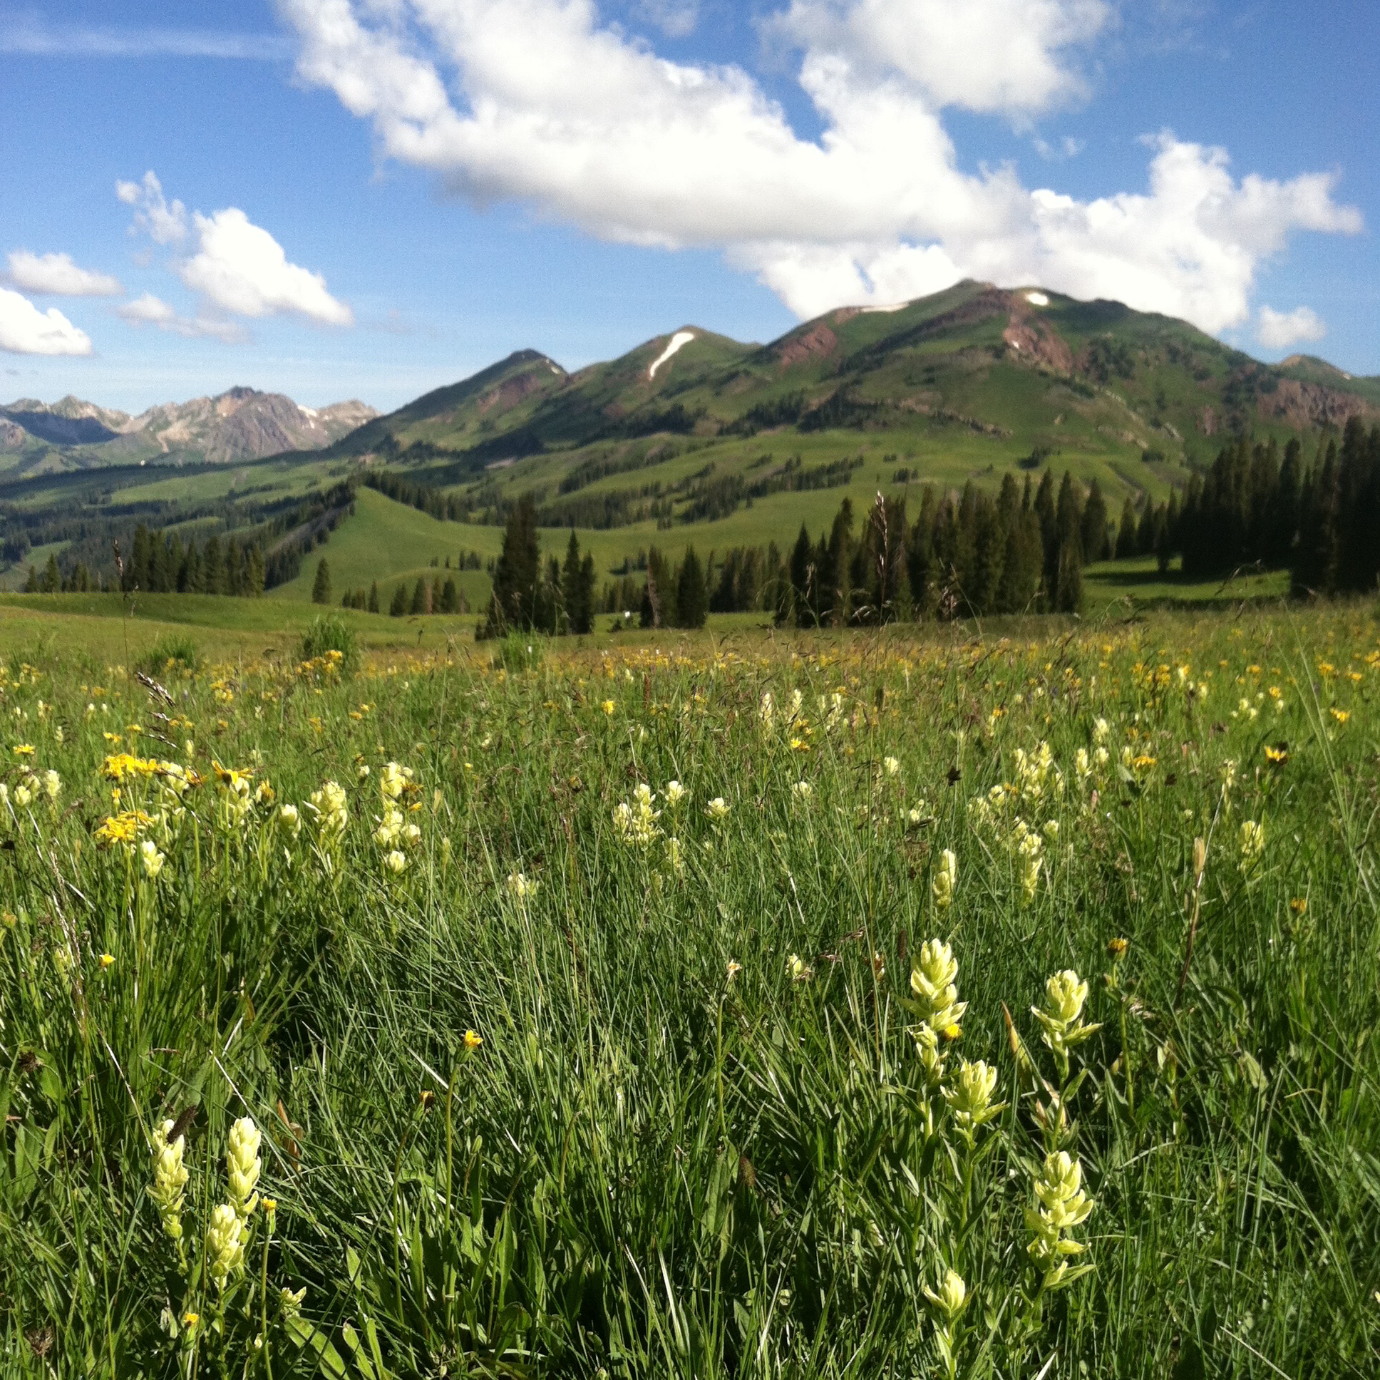
Questions or comments?
Notes:
----- Meeting Notes (2/29/16 16:20) -----
Beginning: headlining papers with graphs to sum things up

